Slide 1
Medical Insurance
Charges
Zengxiaoran Kang
Fang Shu
Qiying Tao
Mingyue Wang

Slide 2
Introduction
Medical Insurance is a major concern for everyone. However, the charges of medical insurance varies by different factors.
We constructed a prediction model to estimate insurance charges while providing more insights on the effect of each factor.
This report utilized an insurance dataset obtained from the book Machine Learning with R by Brett Lantz.
Notes:
Medical insurance is an essential part of people’s self-protection plan as it covers a person’s medical expenses for illness or injury. However, various factors of each individual may affect their medical insurance charges, such as age, body condition, and more.
The data were analyzed using JMP to examine the relationship between features indicating individual characteristics and the corresponding health insurance charges.

Slide 3
Data Description
The data contains relative information about each person and each corresponding charge billed by health insurance companies. There are 1338 observations and 7 variables included.
age: age of primary beneficiary (in years)
sex: “Male”or “Female”
bmi: body mass index
children: number of dependents covered by health insurance
smoker: “Yes”or “No”
region: the beneficiary's residential area in the US; “northeast”, “southeast”, “southwest”, or “northwest”
charges: individual medical costs billed by health insurance (in dollars)

Slide 4
Objective
insurance
To identify the most significant attributes relative to insurance charge.
To build a validated regression model for predicting insurance charge.

Slide 5
Hypothesis Test
Model: charges = β₀ + β₁∗age + β₂∗Charges_Categorical + β₃∗bmi + β₄ ∗children + β₅∗smoker + β₆∗region + β₇∗bmi∗smoker + β₈∗sex + β₉∗Charges_Categorical∗bmi
H₀: All the β coefficients are equal to 0: β₁=β₂=β₃=β₄=β₅=β₆=β₇=β₈=β₉=0. In other words, none of the explanatory variables is statistically significant.
Hₐ: At least one of the β coefficient is not equal to 0. In other words, at least one of the explanatory variables is significant.
H₀: The Model does not have predictive ability (the model is nonsignificant)
Hₐ: The Model has predictive ability (the model is significant)
Notes:
Since the corresponding p-values for each explanatory variable is less than the alpha value of 0.05, we reject H₀. This means we have sufficient evidence to conclude that at least one of the β coefficients is significant. In fact, all the explanatory variables turned out to be significant.

Slide 6
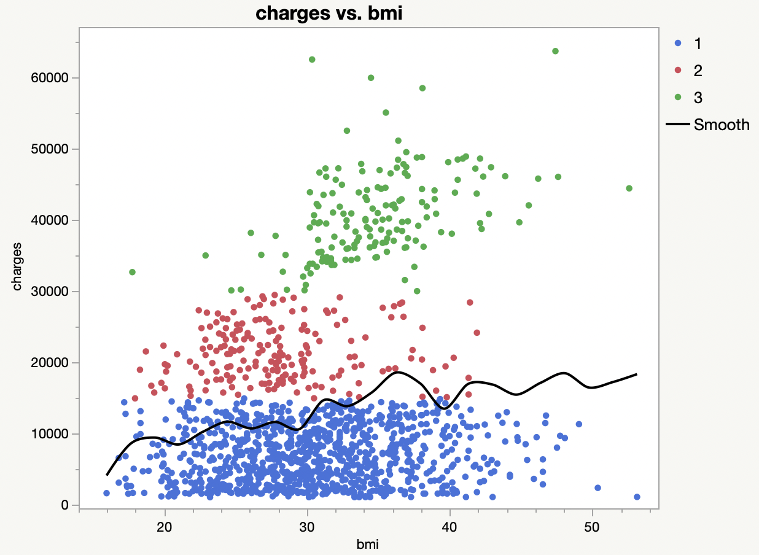
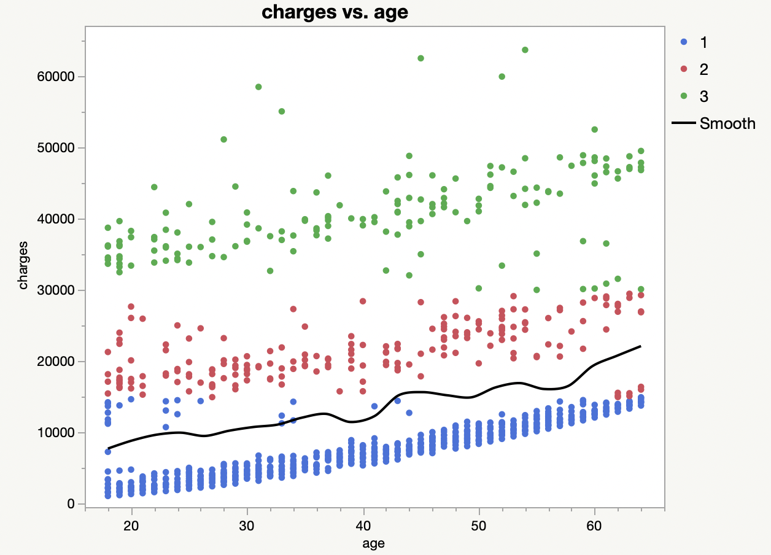
Data Cleaning
Create A New Categorical Factor to Differentiate Charges
Figure 1. Scatterplot of charges vs bmi and charges vs age
The observations indicated a necessity to classify "charges" into three categories.
Group 1 (low-charges) : ≤ 15000 dollars
Group 2 (medium-charges): > 15000 and ≤ 30000 dollars.
Group 3 (high-charges): > 30000 dollars.
Notes:
ANCOVA

Slide 7
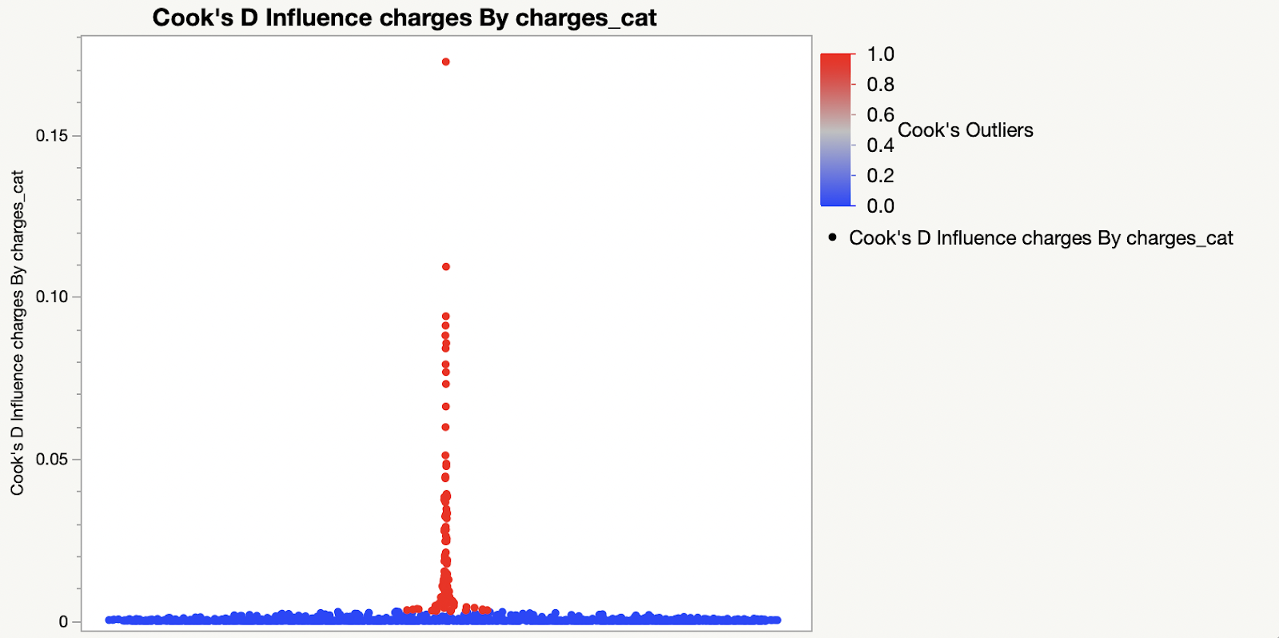
Data Cleaning
Filtered Influencers with Cook’s Distance
Using Cook’s Distance to remove influential observations
The threshold 4/(n-2), where n is the number of observations, was used to identify points that may have a negative influence
A total of 113 points were excluded from the analysis
Split to Training and Testing data
Split data into training and testing sets at a 7:3 ratio.
Fit and develop the model on training set and verify the result with the testing set
Figure 2. Cook’s D plot for Observations
Notes:
We used Cook’s distance to find or remove influential observations in the set of predictor variables to receive a better regression model. The threshold 4/(n-2), where n is the number of observations, was used to compare with the calculated Cook’s distance (using JMP) to identify points that may have a negative influence. A point was treated as an influential points if it it had a Cook’s distance larger than the threshold; thus, a total of 113 points were excluded from the analysis.

Slide 8
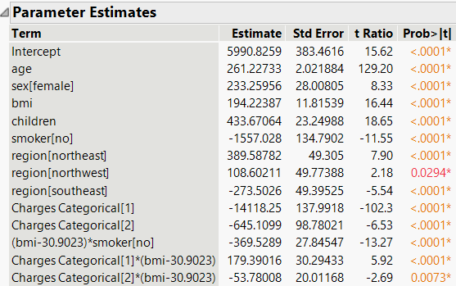
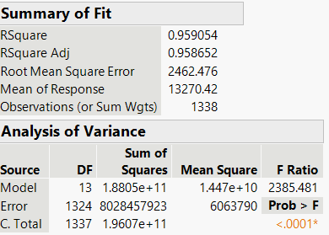
Data Analysis and Results
Forward Selection
All seven main effects were significant
The interaction between bmi and smoker and the interaction between Charges Categorical and bmi were significant
None of the three-way interactions were significant
Figure 3. Parameter Estimates of the Selected Predictors and Summary of Fit of Selected Model
Notes:
And if we add 3-way interactions, the adjusted R^2 decreases

Slide 9
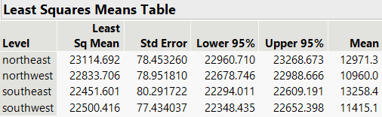
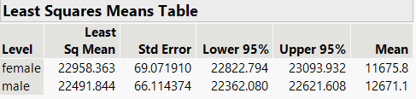
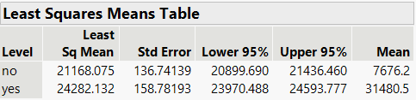
Effect tests Significant Factors
The insurance charge differs by region, with the northeast region having a higher average charge than the other three regions.
The insurance charge differs by gender, with females having a higher average charge.
The insurance charge differs by whether a person smokes or not, with smokers having a higher charge.

Slide 10
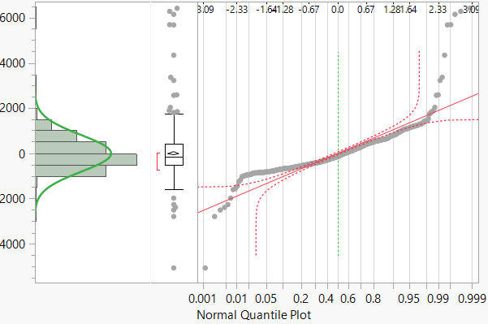

Normality Check
Figure 4. Normality test of Residuals
Notes:
To see whether the observations are normally distributed, we plot the residuals and conduct a Goodness-of-Fit test. Since the p-value in the Shapiro-Wilk test is less than the alpha value of 0.05, we reject the null hypothesis and conclude that the residuals are not normally distributed.

Slide 11
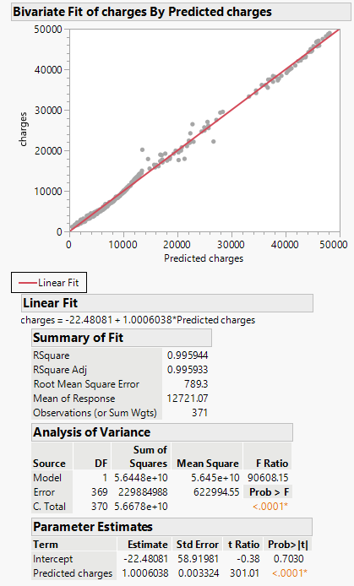
Model fit on testing data
Figure 5. Model Fitting on Testing Data
Notes:
By assuming that the normality assumption is satisfied, all of the explanatory variables in the model are significant.
We test our model with the testing data.
We found that the model was significant and had a high R² value of 0.9959.

Slide 12
Conclusions
The normality assumption is violated.
We rejected both null hypothesis.
The model is significant and fits well on the testing data.
Explanatory variables are significant.
Significant factors
The charge’s category (low, medium, high standard)
BMI
Children
Smoker
Residential region in the U.S.
Sex
BMI with smoker
Charge’s category with BMI
Notes:
Although the normality assumption is violated under the 0.05 alpha threshold, the model is proved to help budget a person’s insurance charges as described above. In addition, we successfully rejected our null hypothesis and identified that the charge’s category (low, medium, high standard), bmi, children, smoker, residential region in the U.S., sex, and two interaction effects, bmi with smoker and charge’s category with bmi, are significant towards our model.
A major limitation of the study was that we manually created an additional variable charge category to describe the clustering of data, which is not given by the data providers and thus requires further consideration when deploying the model into practical use. Our model requires each individual to set an expectation towards his expenses on medical insurance before making a prediction. Perhaps other methods such as the K-means clustering can be applied to identify the charge's category. Furthermore, we removed about 7% of bad influencers with Cook’s distance, which can be explored further for the interest of study.

Slide 13
Reference
Choi, Miri. “Medical Cost Personal Datasets.” Kaggle, 21 Feb. 2018, https://www.kaggle.com/mirichoi0218/insurance.
Cook R.D. (2011) Cook’s Distance. In: Lovric M. (eds) International Encyclopedia of Statistical Science. Springer, Berlin, Heidelberg. https://doi.org/10.1007/978-3-642-04898-2_189
Checking the Normality of a Sample. (2020, August 11). University of New South Wales. https://stats.libretexts.org/@go/page/826
B. HuitemaThe Analysis of Covariance and Alternatives: Statistical Methods for Experiments, Quasi-experiments, and Single-case Studies
Wiley, Chichester (2011)

Slide 14
Q & A
Thank you!

